Slide 1
Central Selkirks
Maternity Pen
Cory Legebokow
Ecosystem Specialist
BC Caribou Recovery Team

Slide 2
Agenda
Population Status
Implemented Management Actions
Conditions Supporting Maternal Penning
ALCS Maternity Pen Facility
Risks and Mitigative Measures
Questions

Slide 3
Central Selkirks Population Status
The CS herd reduced from 92 to 28 animals (26 adults & 2 calves) from 2010 to 2021 and has seen a total decline of 84% since 1997. With only 2 calves observed in 2020 the recruitment rate of 7.1% is far below the 16% necessary to just stabilize the herd.
Without immediate management interventions the CS herd is expected to be functionally extirpated (<8 adult females) in less than 5 years (Wildlift Model).

Slide 4
Central Selkirks Implemented Management Actions
Habitat Protection: 650,624 ha (79.4%) of core habitat is protected through no harvest zones under the Forest & Range Practices Act and through Parks & Protected Areas. This is amongst the highest level of core habitat protection of all BC herds.
Predator Management: Direct management of both wolves and cougars has been occurring for the past 2 winters and is continuing this winter. A total of 23 wolves and 10 cougars have been removed for an estimated density of 1.6 wolves/1000 km² (target is a max of 3/1000 km2).
Public Recreation Management: Extensive snowmobile closures within critical habitat including permanent closures and closures based on collar locations

Slide 5
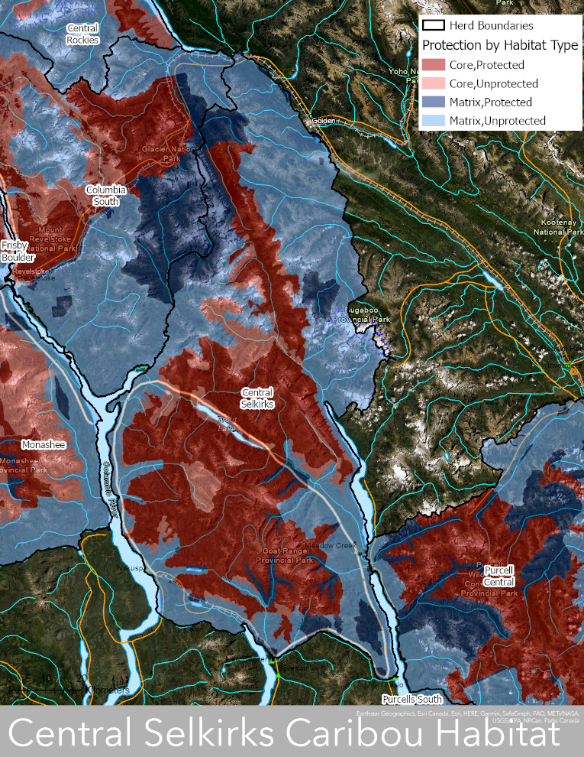
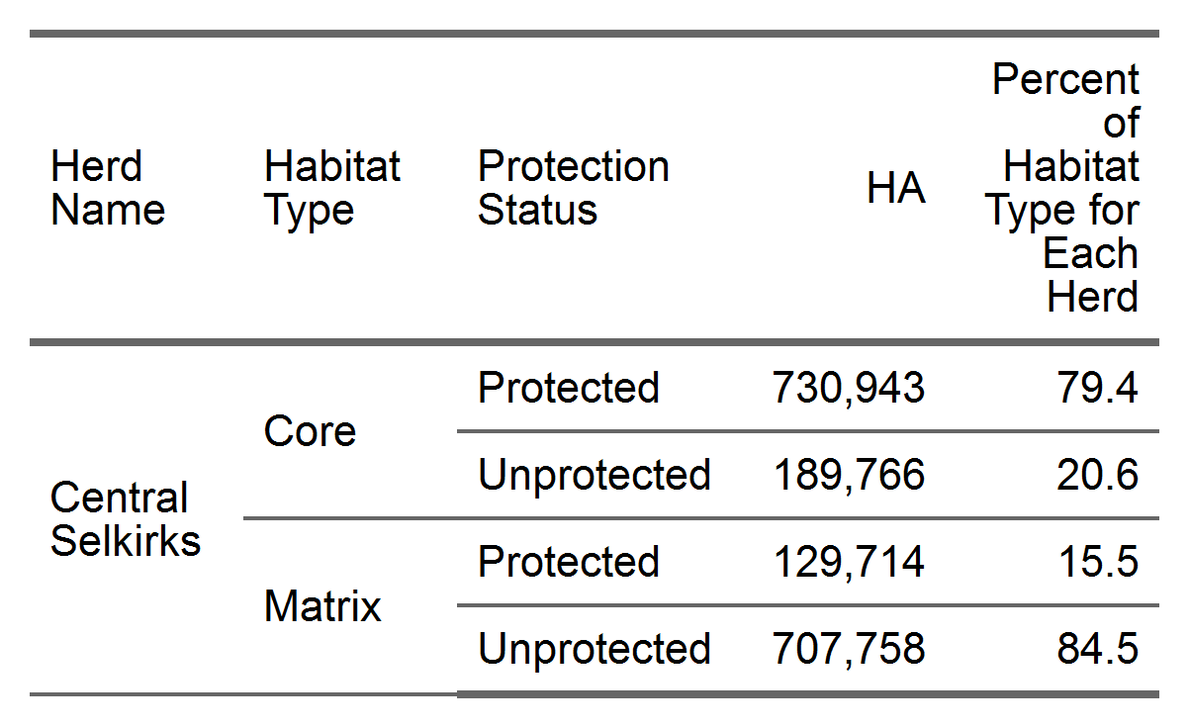

Slide 6
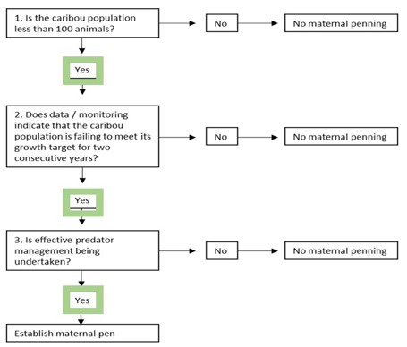
Conditions Supporting Maternal Penning
Yes (n=28)
Yes (declining vs stabile or increasing)
Yes (2 years completed, 3rd year in progress)

Slide 7
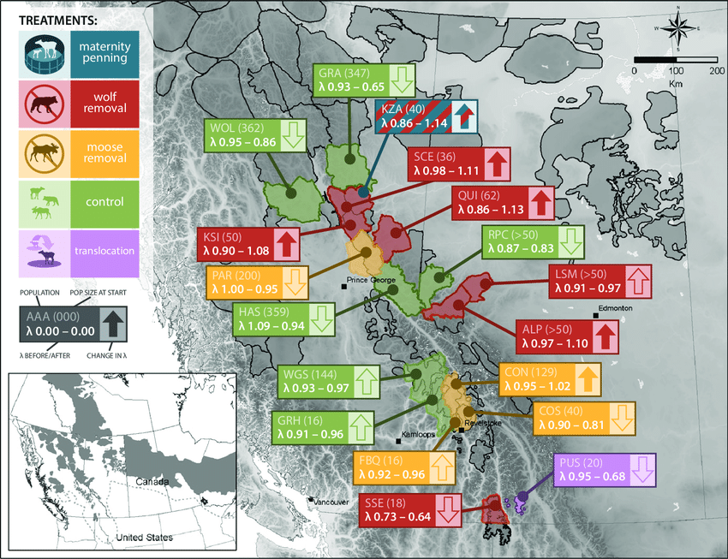
Serrouya et al. (2019) found combined recovery treatments that focused on increasing adult female survival through wolf reduction and calf recruitment through maternal penning resulted in the highest population growth rates compared to populations with single treatments.
Combined recovery treatments including predator management and maternal penning applied on the Klinse-Za herd resulted in a significant population growth rate (λ) increase from 0.86 to 1.14 (Serrouya et al. 2019) resulting in the population almost tripling since 2013

Slide 8
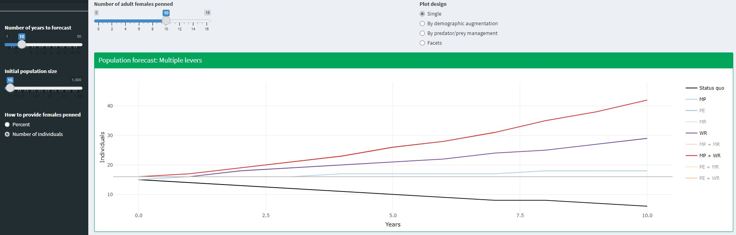
Wildlift modelled effects on the number of adult females for individual treatments of maternal penning (MP, n=18, λ=1.016)
and wolf reduction (WR, n=29, λ=1.062) as well as combined treatments (MP+WR, n=42, λ=1.103) applied to the Central
Selkirks over 10 years.

Slide 9

ALCS Maternity Pen Site
Location: Kuskanax Creek watershed approx. 10 km NE of the Village of Nakusp and immediately upslope of the Nakusp Hot Springs. The site is considered matrix habitat and is approx. 1 km away from core habitat. Approximately 75% of the pen is located within the municipal boundary of the Village of Nakusp
Size: 6.6 ha (1.2 km perimeter)
Elevation: 835 – 880 m ASL (RCRW 590 m)
Slope: approx. 15%
Aspect: South
BEC: Interior Cedar Hemlock moist wet 2 (ICH mw2)
Current Forest Cover: Closed canopy mature hemlock dominant stand

Slide 10
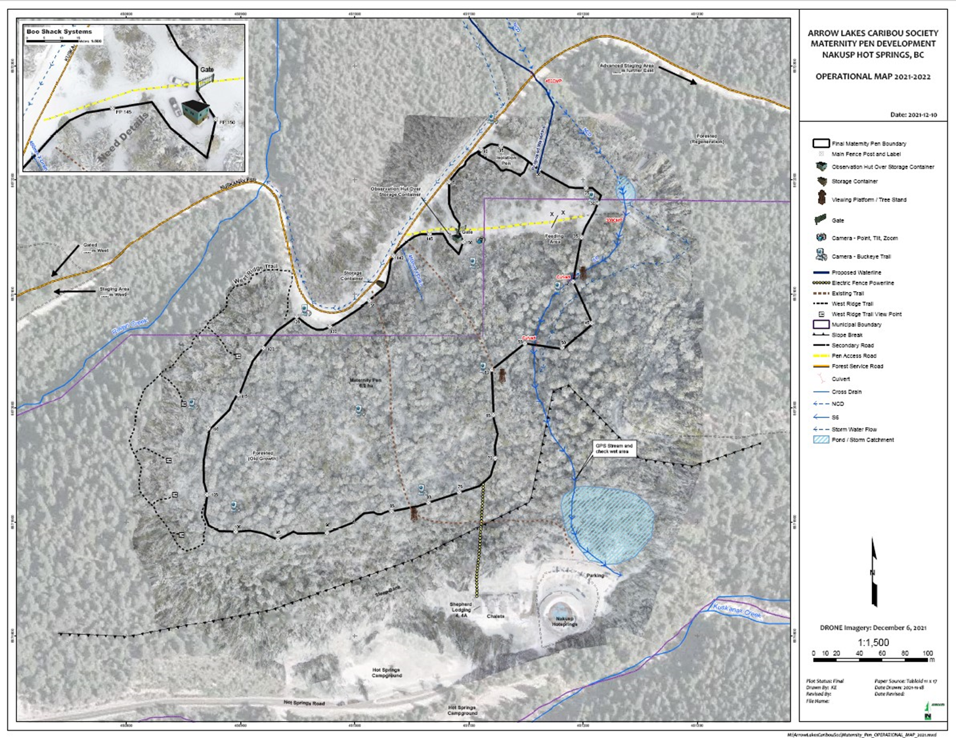

Slide 11
Risks & Mitigative Measures
Risk: Injury or mortalities due to animal handling, transport & rearing
Mitigative Measures: The Animal Care Plan details all measures related to animal husbandry including accepted capture, handling and transport methodologies. The same protocols were followed by the Revelstoke pen during which there were no capture related mortalities or significant injuries. Physical risks within the pen
(i.e., blowdown, etc.) have been reduced.
Risk: Predators could enter the pen and kill adults or calves
Mitigative Measures: The facility is enclosed by a 3.5 m high geotextile wall surrounded
by a 2.5 m high 5000 V electric fence. This design proved to be effective at the Revelstoke
pen. In addition, a 0.5 m skirt at the bottom of the geotextile wall is buried to prevent digging.

Slide 12
Risks & Mitigative Measures (cont)
Risk: In-pen temperatures are outside of the range of those within known in-situ Central Selkirks calving grounds
Mitigative Measures:
Stockpiling of snow at the Revelstoke pen was found to be an effective respite for animals.
Stockpiling at the Nakusp pen prior to capture will be significantly more than was done at RCRW.
The snow will be stockpiled at 2 locations and buried under wood chips to prolong its life.
The pen will have misting stations that can cool ambient air temperatures by as much
as 15 C. The mist will also provide respite from insects.
The water source for the pen is sufficient to support snowmaking. Systems are currently being sourced.
Forest cover at the Nakusp pen is significantly higher than the Revelstoke pen. Over 90% of the site
is under dense forest canopy which may help keep ambient air cooler.

Slide 13
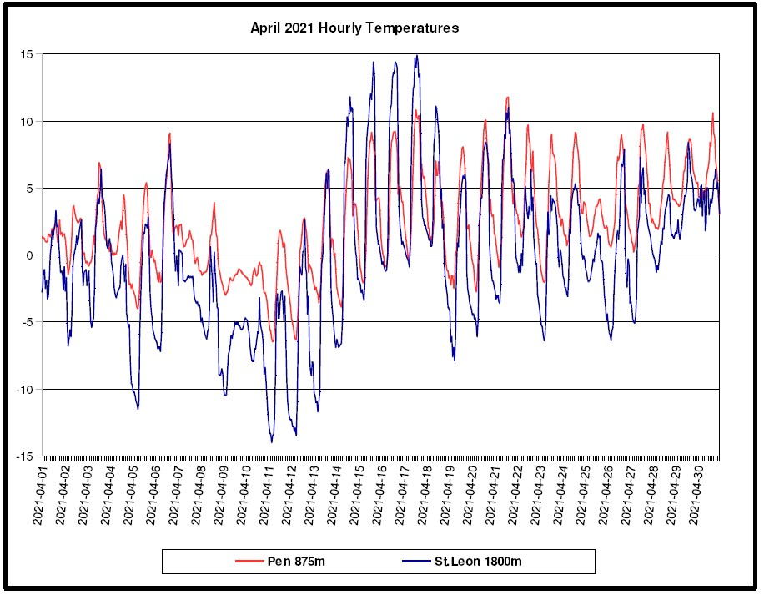

Slide 14
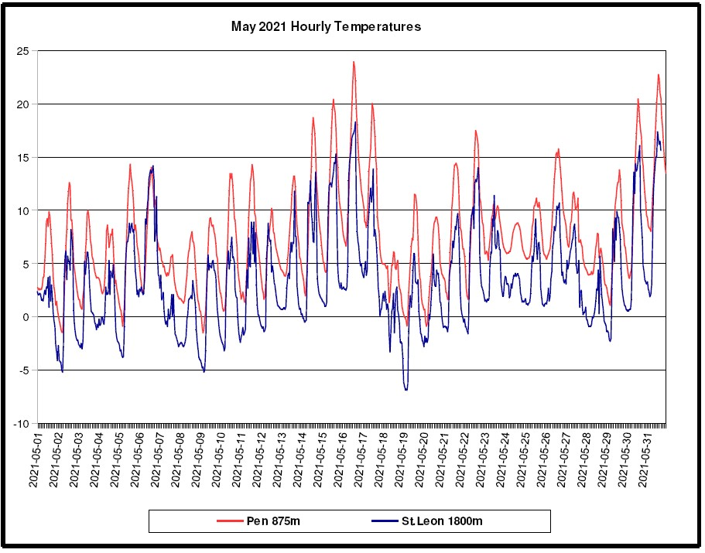

Slide 15
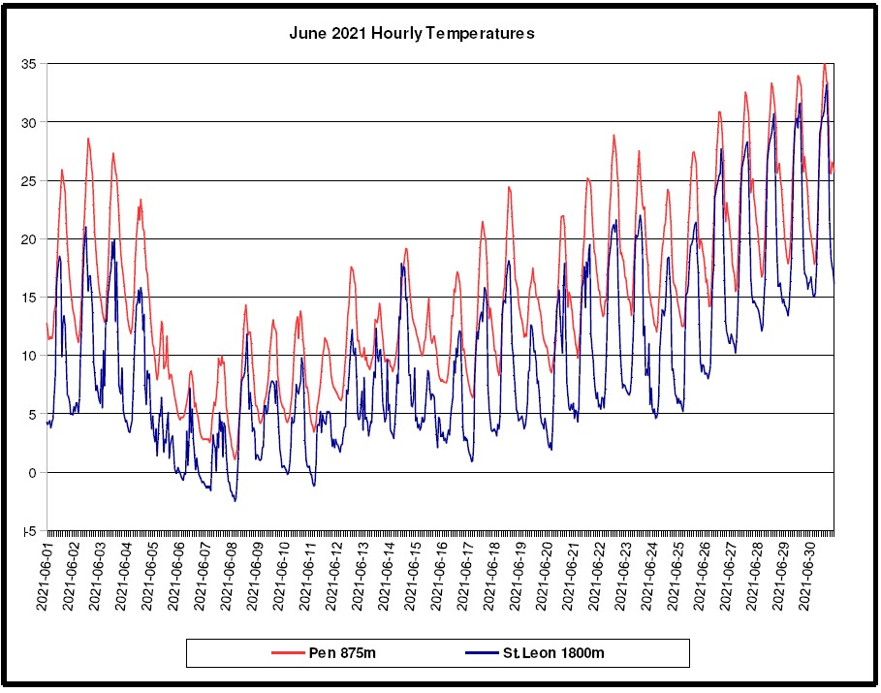

Slide 16
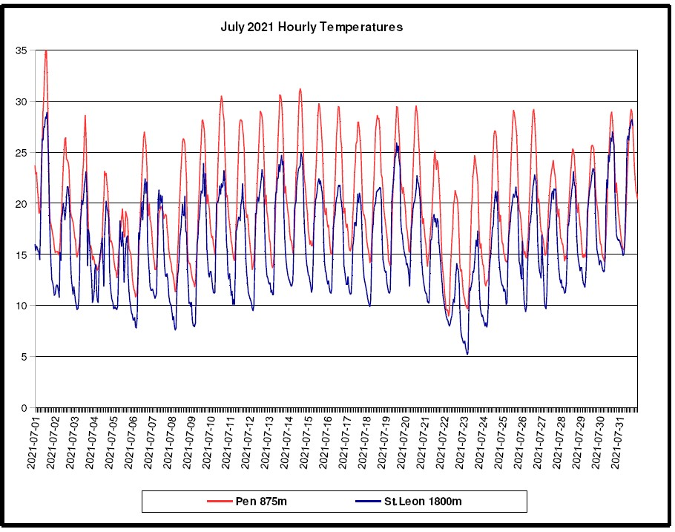

Slide 17
Risks & Mitigative Measures (cont.)
Risk: Physical disturbance
Proximity to a CMH fuel cache approx. 1 km away
An unofficial trail that starts at the Nakusp Hot Springs parking lot and goes along the western flank of the pen.
The Raven Creek FSR runs along the northern flank of the pen that provides access to a snowmobile
staging area
Mitigative Measures:
CMH’s last day of skiing is March 24th. The earliest that capture would occur is March 14th
which could result in a 10-day overlap with heliskiing operations. Its most likely that capture will occur once CMH’s operations have ceased.

Slide 18
Risks & Mitigative Measures (cont.)
Mitigative Measures: (Physical disturbance cont.)
A NOTAM will be established through Transport Canada to close airspace above the pen (460 m radius by 610 m high bubble). This will provide a disturbance buffer if capture overlaps CMH operations in addition to all other helicopters in the valley throughout the captive period.
Game cam monitoring of the unofficial trail from the Nakusp Hot Springs indicates very low use as
the trailhead is not marked or obvious. A gate will be placed on the trail including a sign stating its
closed due to the high voltage fence. If necessary, the trail can be legally closed through a
Bylaw established by the Village of Nakusp.
Alpine snowmobiling above the pen is governed by Permits issued under the Wildlife Act.
An assessment of the noise generated by vehicles and snowmobiles travelling past the
pen was deemed to be low and acceptable to the provincial wildlife veterinarian. Regardless,
the riding area can be promptly closed if noise levels are identified as a concern.

Slide 19
Risks & Mitigative Measures (cont.)
Mitigative Measures: (Physical disturbance cont.)
Once snow melts, use of the Raven Creek FSR remains very low as theres no forestry operations occurring and public recreation in the area is very low.
All vehicle traffic will be controlled. If noise is deemed to be high the Selkirk District Resource Manager has determined that a gate can be placed on the FSR to close all public access.
Buckeye game cameras will monitor the pen perimeter. The cameras are directly linked by
cell phone to key project staff.
Additional Risk Mitigation Measures
Animal care and health is the top priority for the Nakusp pen. Daily monitoring data of
animal health and rearing conditions will be digitally entered accessed by key project staff at any time.
If it's determined that the animals are at risk immediate measures will be applied, including early release
as was done at the Revelstoke pen.

Slide 20
Risks & Mitigative Measures (cont.)
Additional Risk Mitigation Measures (cont.)
Animal care protocols will be based on those used at the Revelstoke pen and adapted where
necessary to reflect local conditions.
A covid-19 safety plan is being developed to address potential risks to animals and staff.
  Everyone involved with animal handling either during capture or captivity will be required to
  have a negative covid-19 result as determined by rapid tests.
  Project results will be reviewed annually and measured against project objectives. If results
  are not being achieved or if risks to animals are deemed unacceptable no further
  captures will occur.

Slide 21
Questions
Arrow Lakes Caribou Society: https://arrowlakescaribousociety.com/

